Slide 1
Quantum tunneling, A Numerical study
MD AFSAR REJA
Supervisor : Awadhesh Narayan
SSCU, IISc
Reference: Simulations in quantum tunneling by Kevin Smith, and Guy Blaylock
American Journal of Physics 85, 763 (2017); https://doi.org/10.1119/1.4991367

Slide 2
Overview:
Introduction
Crank-Nicolson method
Applying Crank-Nicolson method to 1D TDSE
Simulation set up
Results
Experimental realization

Slide 3
Introduction
Differential Equation are quite common in physics
Heat equation, Newton equation of motion, Schrodinger equation
Euler, RK2, RK4
Crank Nicolson

Slide 4
Why Crank Nicolson
Unconditionally Stable
Probability conserved
Computationally cheap

Slide 5
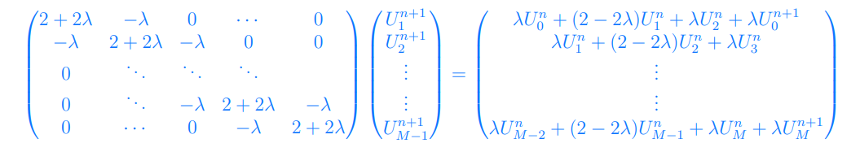
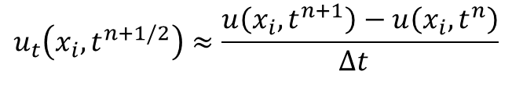
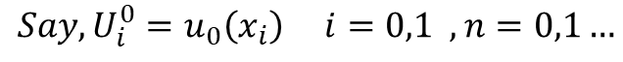
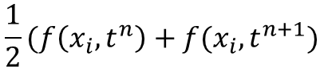
Crank-Nickelson Method :
$$u_{t}=v u_{xx} (x,t)$$
$$u_{t}\left(x_{i},t^{n+1/2}\right)≈\frac{u\left(x_{i},t^{n+1}\right)−u\left(x_{i},t^{n}\right)}{Δt }$$
$u_{xx}(x_{i},t^{n+1/2}$)$≈\frac{1}{2}[\frac{u\left(x_{i+1},t^{n+1}\right)−2u\left(x_{i},t^{n+1}\right)+u\left(x_{i−1},t^{n+1}\right)}{Δx^{2} }$ + $\frac{u\left(x_{i+1},t^{n}\right)−2u\left(x_{i},t^{n}\right)+u\left(x_{i−1},t^{n}\right)}{Δx^{2} }]$
$$Say, U_{i}^{0}=u_{0}\left(x_{i}\right) i=0,1 , n=0,1…$$
$$\frac{U_{i}^{n+1}−U_{i}^{n}}{Δt}=\frac{1}{2}[\frac{U_{i+1}^{n+1}−2U_{i}^{n+1}+U_{i−1}^{n+1}}{Δx^{2} }\text{ +} \frac{U_{i+1}^{n}−2U_{i}^{n}+U_{i−1}^{n}}{Δx^{2} }]$$
$$\frac{1}{2}(f\left(x_{i},t^{n}\right)+f(x_{i},t^{n+1})$$

Slide 6
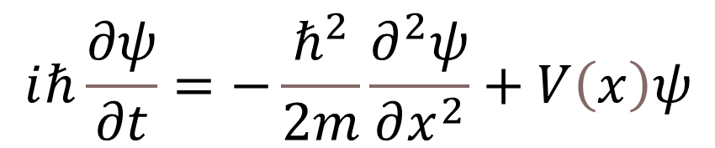
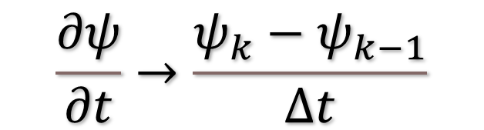
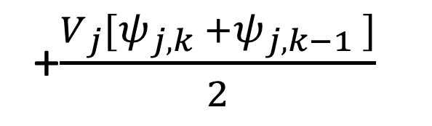
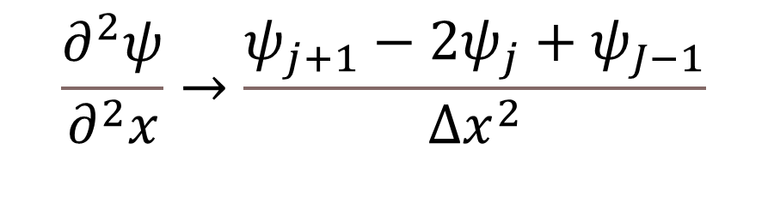
Applying Crank-Nicolson method on TDSE
$$\frac{∂ψ}{∂t}→\frac{ψ_{k}−ψ_{k−1}}{Δt}$$
$$ⅈℏ\frac{∂ψ}{∂t}=−\frac{ℏ^{2}}{2m}\frac{∂^{2}ψ}{∂x^{2}}+V\left(x\right)ψ$$
$$\frac{∂^{2}ψ}{∂^{2}x}→\frac{ψ_{j+1}−2ψ_{j}+ψ_{J−1}}{Δx^{2}}$$
$ⅈℏ \frac{ψ_{j,k} −ψ_{j,k−1}}{∆t}$ = $\frac{ℏ^{2}}{2m}\frac{\left[ψ_{j+1,k} −2ψ_{j,k}+ψ_{j−1,k}\right]+\left[ψ_{j+1,k−1} −2ψ_{j,k−1}+ψ_{j−1,k−1}\right]}{2∆x^{2}}$
+$\frac{V_{j}[ψ_{j,k} +ψ_{j,k−1} ]}{2}$

Slide 7
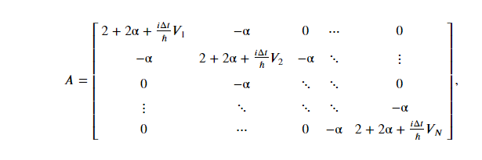
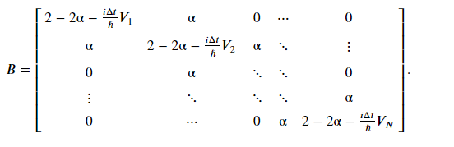


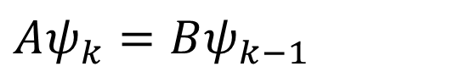
1D TDSE contd…
$$\left(2+2α+\frac{iΔt}{ℏ}V_{j}\right)ψ_{j,k} − αψ_{j+1,k}−αψ_{j−1,k}=\left(2−2α−\frac{iΔt}{ℏ}V_{j}\right)ψ_{j,k−1}− αψ_{j+1,k−1}+αψ_{j−1,k−1}$$
Where, $α=\frac{ⅈℏΔt}{2mΔx^{2}}$
$Aψ_{k}=Bψ_{k−1}$
$ψ_{k}=A^{−1}$B $ψ_{k−1}=Cψ_{k−1 }$

Slide 8
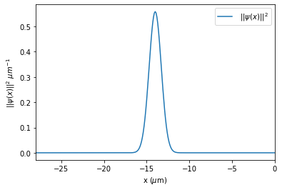
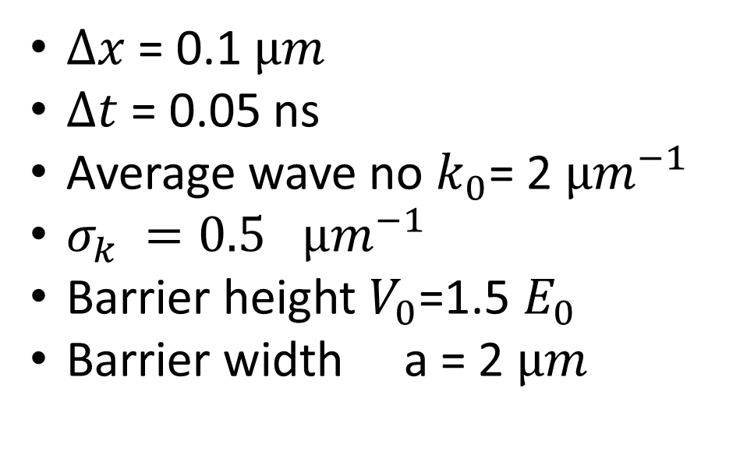
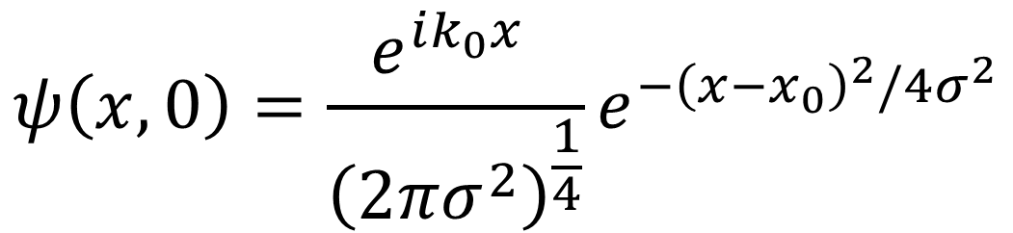
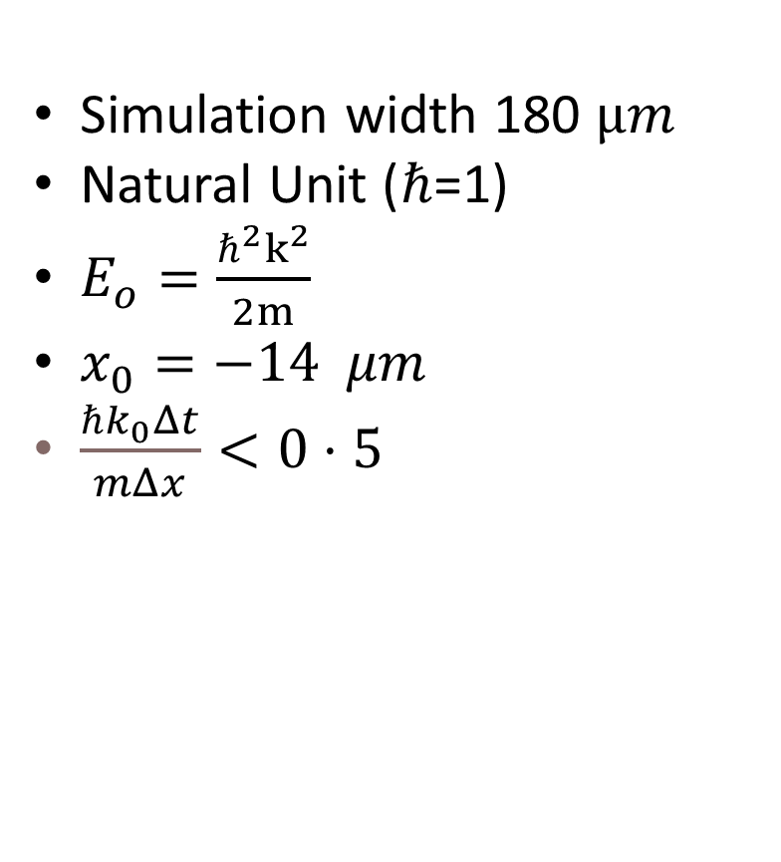
Simulation set up
$$ψ\left(x,0\right)=\frac{e^{ik_{0}x} }{{\left(2πσ^{2}\right)}^{\frac{1}{4}}}e^{−{\left(x−x_{0}\right)}^{2}/4σ^{2}}$$
$Δx$ = 0.1 $µm$
$Δt$ = 0.05 ns
Average wave no $k_{0}$= 2 $µm^{−1}$
$σ_{k} =0.5$ $µm^{−1}$
Barrier height $V_{0}$=1.5 $E_{0}$
Barrier width a = 2 $µm$
Simulation width 180 $µm$
Natural Unit ($ℏ$=1)
$E_{o}=\frac{{ℏ^{2}k}^{2}}{2m}$
$x_{0}=−14 μm$
$\frac{ℏk_{0}Δt}{mΔx}<0⋅5$

Slide 9
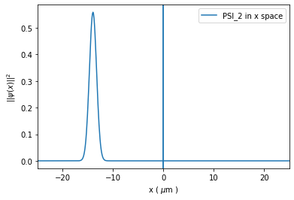
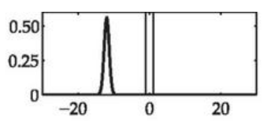
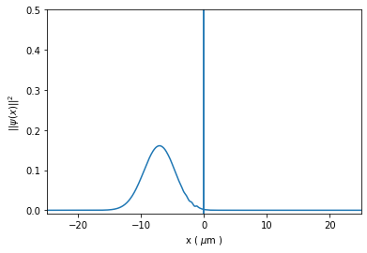
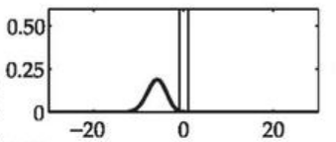
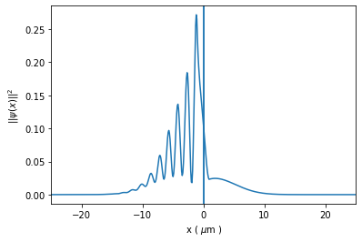
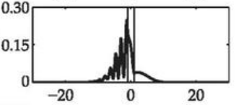
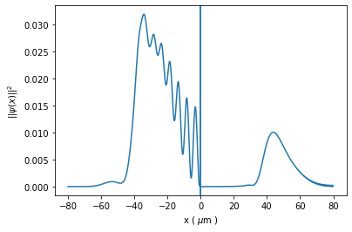
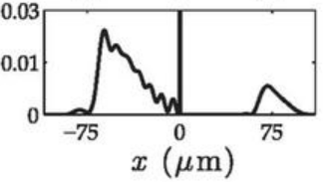
Reproduced Results

Slide 10
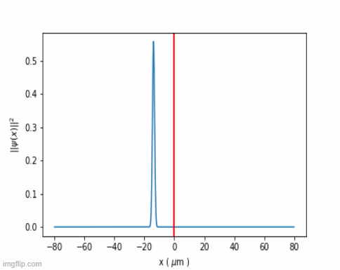
Time evolution of the wave packet

Slide 11
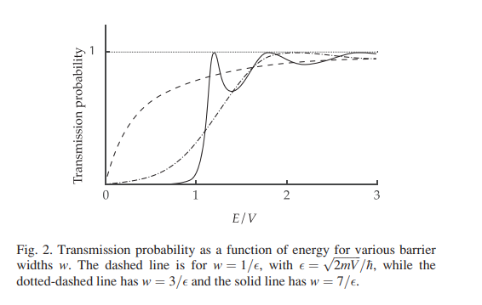
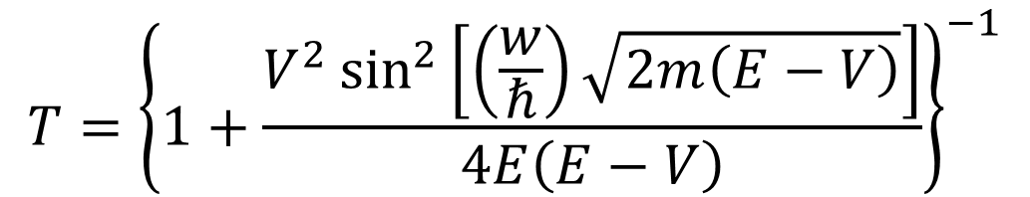
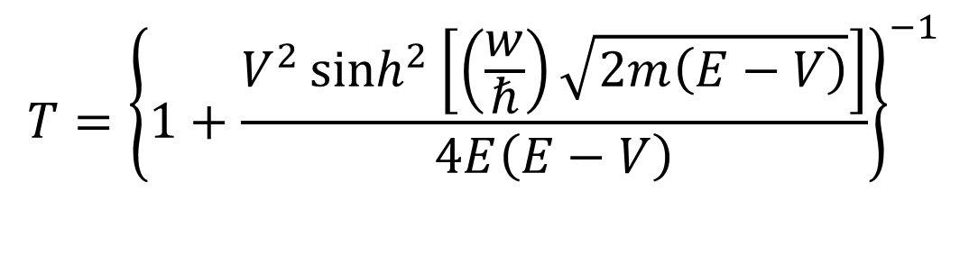
Analytical result
$$T={\left\{1+\frac{V^{2}\sinh^{2}\left[\left(\frac{w}{ℏ}\right)\sqrt{2m\left(E−V\right)}\right]}{4E\left(E−V\right)}\right\}}^{−1}$$
$$T={\left\{1+\frac{V^{2}\sin^{2}\left[\left(\frac{w}{ℏ}\right)\sqrt{2m\left(E−V\right)}\right]}{4E\left(E−V\right)}\right\}}^{−1}$$

Slide 12
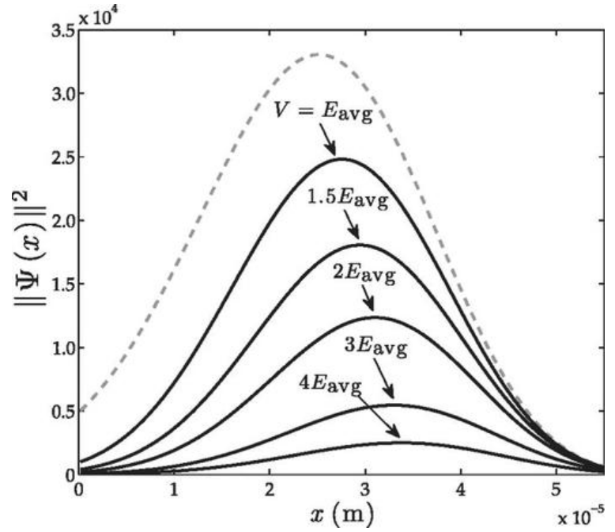
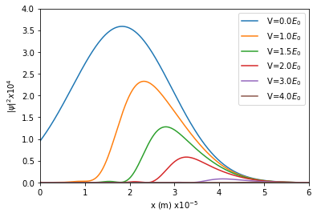
Transmitted wave with barrier heights…

Slide 13
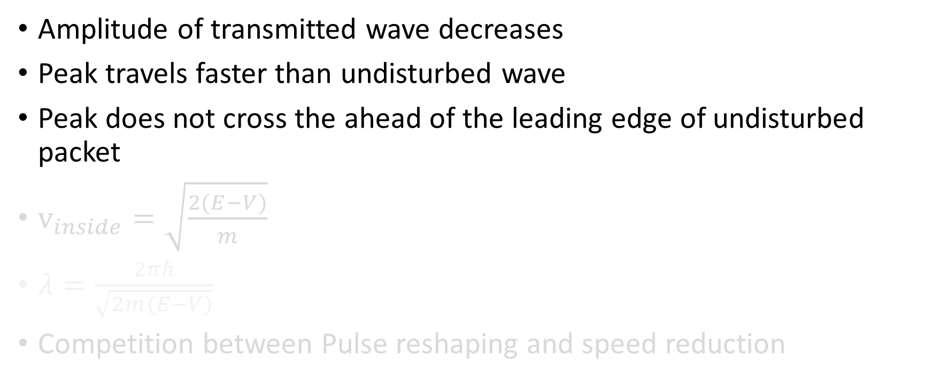
Discussion
Amplitude of transmitted wave decreases
Peak travels faster than undisturbed wave
Peak does not cross the ahead of the leading edge of undisturbed packet
$v_{inside}=\sqrt{\frac{2(E−V)}{m}}$
$λ=\frac{2πℏ}{\sqrt{2m(E−V)}}$
Competition between Pulse reshaping and speed reduction

Slide 14
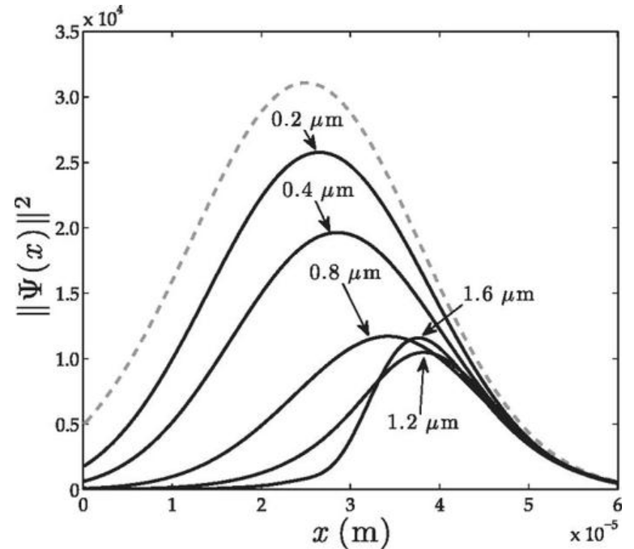
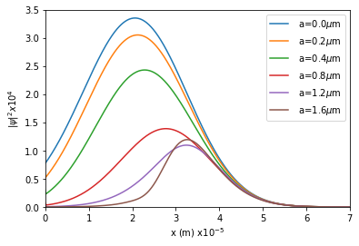
Transmitted wave with barrier widths…

Slide 15
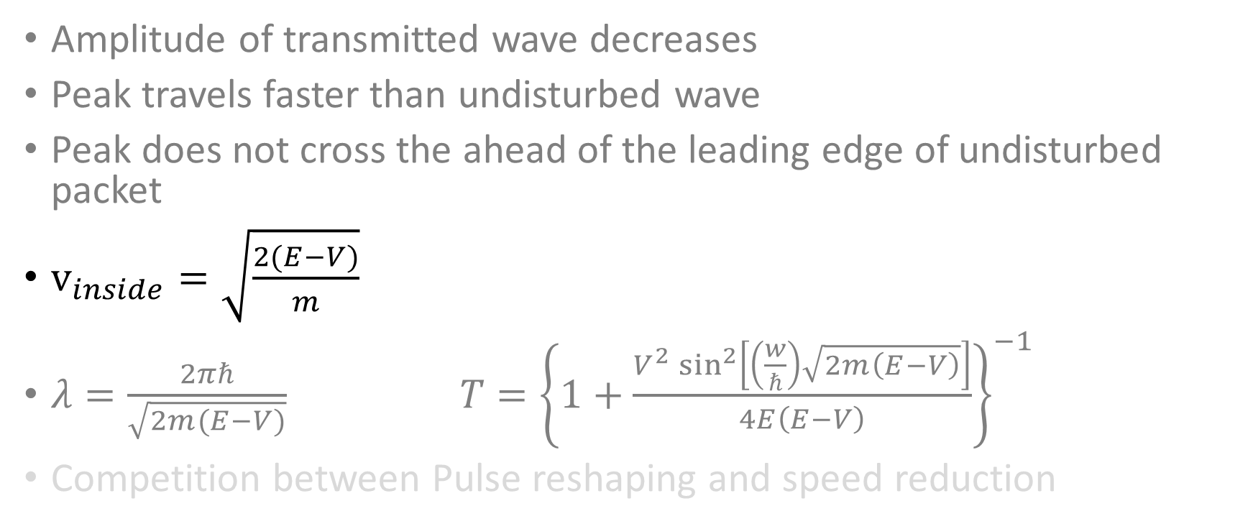
Discussion
Amplitude of transmitted wave decreases
Peak travels faster than undisturbed wave
Peak does not cross the ahead of the leading edge of undisturbed packet
$v_{inside}=\sqrt{\frac{2(E−V)}{m}}$
$λ=\frac{2πℏ}{\sqrt{2m(E−V)}} T={\left\{1+\frac{V^{2}\sin^{2}\left[\left(\frac{w}{ℏ}\right)\sqrt{2m\left(E−V\right)}\right]}{4E\left(E−V\right)}\right\}}^{−1}$
Competition between Pulse reshaping and speed reduction

Slide 16
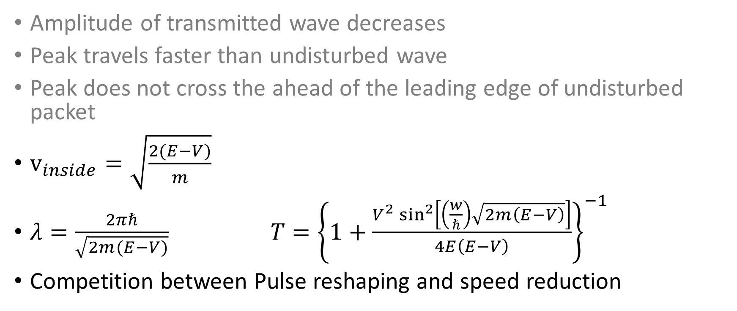
Discussion
Amplitude of transmitted wave decreases
Peak travels faster than undisturbed wave
Peak does not cross the ahead of the leading edge of undisturbed packet
$v_{inside}=\sqrt{\frac{2(E−V)}{m}}$
$λ=\frac{2πℏ}{\sqrt{2m(E−V)}} T={\left\{1+\frac{V^{2}\sin^{2}\left[\left(\frac{w}{ℏ}\right)\sqrt{2m\left(E−V\right)}\right]}{4E\left(E−V\right)}\right\}}^{−1}$
Competition between Pulse reshaping and speed reduction

Slide 17
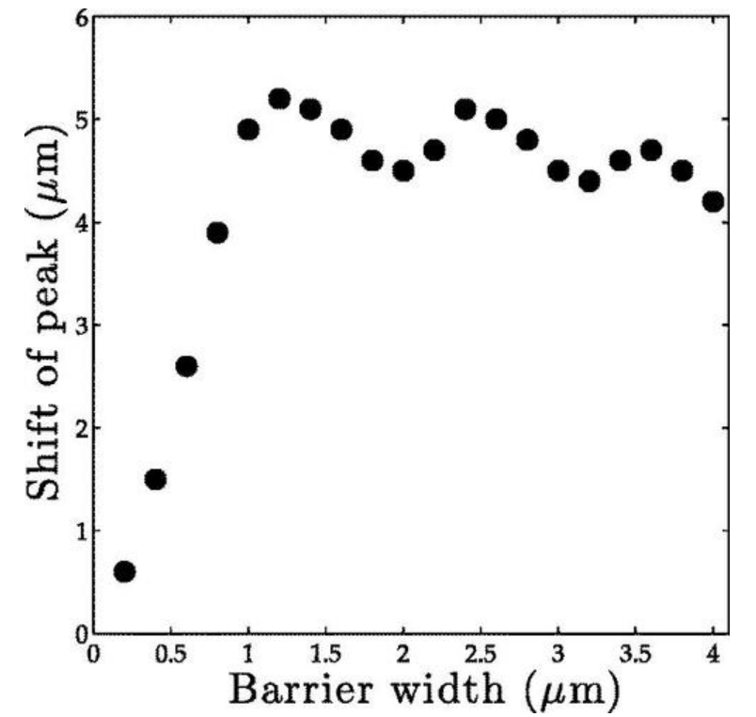
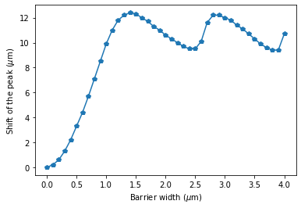
Shift of the transmitted peak…

Slide 18
THANK YOU

